Slide 1

MINI PROJECT “Diabetes Prediction”
Akshay Mani Tripathi (2201640100338)
Sakshi Chauhan (2201640100350)
Divyanka Chaturvedi (2201640100342)
Arman Singh (2201640100340)
Kushagra Tandon (2201640100343)
Project Id: 24_CS_3F_04
Pranveer Singh Institute of Technology
Kanpur - Agra - Delhi National Highway - 19 Bhauti -Kanpur - 209305.
(Affiliated to Dr. A.P.J. Abdul Kalam Technical University)

Slide 2
AGENDA
Introduction
Objective
Implementation
​Feasibility
Scope
Tools and Technology Required
Methodology
Summary
Proposed and Existing system

Slide 3
INTRODUCTION
Diabetes is a growing global health concern, affecting millions and leading to severe complications if left unmanaged. This project aims to leverage machine learning techniques to predict the likelihood of diabetes in individuals based on key health metrics. By analyzing patterns in medical data, we seek to create a predictive model that can assist healthcare providers in identifying at-risk patients early. This proactive approach not only empowers individuals to make informed lifestyle changes but also aims to improve overall healthcare efficiency and outcomes in diabetes management.

Slide 4
OBJECTIVE
Promote Awareness:
Increase awareness about diabetes prevention and encourage lifestyle changes among at-risk populations.
Develop a Predictive Model:
Create an accurate machine learning model to assess diabetes risk based on health metrics.
Early Detection:
Enable early identification of individuals at risk for diabetes to facilitate timely intervention.
Data Analysis:
Analyze key health parameters to understand their contributions to diabetes risk.
Improve Healthcare Outcomes:
Enhance patient management and treatment strategies through informed decision-making.

Slide 5
IMPLEMENTATION
Objective:
Develop a machine learning model to predict diabetes using patient medical data.
Dataset:
Utilize the Pima Indians Diabetes Dataset containing features like glucose levels, blood pressure, and body mass index (BMI).
Steps Involved:
Data Loading:
Load the dataset using Pandas.
Data Preprocessing:
Handle missing values.
Normalize feature values using StandardScaler.
Feature and Target Separation:
Separate features (X) from the target variable (y).
Train-Test Split:
Split the dataset into training (80%) and testing (20%) sets using train_test_split.

Slide 6
Model Selection:
Choose Logistic Regression as the initial model.
Model Training:
Train the model on the training dataset.
Prediction:
Make predictions on the test dataset.
Model Evaluation:
Assess performance using accuracy, precision, recall, and F1 score. Display a confusion matrix for visual insights.
Conclusion:
Present findings, discuss model performance, and potential improvements.

Slide 7
FEASIBILITY
The feasibility of a diabetes prediction system is high due to advancements in technology, data availability, and healthcare infrastructure. Here's a breakdown of the key factors contributing to its feasibility:
Data Availability Feasibility: Large amounts of medical data, such as glucose levels, BMI, and family history, are now widely available through electronic health records (EHRs), clinical studies, and wearable devices.
Impact: The availability of this data makes it possible to train machine learning models and develop accurate prediction systems.
2. Machine Learning and AIFeasibility: Sophisticated machine learning algorithms and artificial intelligence (AI) are readily available and can be effectively applied to medical datasets for predicting diabetes.
Impact: Proven techniques like decision trees, neural networks, and logistic regression can handle complex patterns in health data, increasing the accuracy of diabetes prediction models.

Slide 8
SCOPE
The scope of a diabetes prediction system encompasses early detection, personalized healthcare, and large-scale public health management. By leveraging machine learning models, such a system can predict an individual's risk of developing diabetes based on various factors like age, lifestyle, and medical history. It can be integrated with wearable devices for real-time monitoring and with electronic health records (EHRs) for comprehensive risk assessments.
Additionally, it can serve as a tool for population-level predictions, helping governments and health organizations design preventive strategies. Overall, the system promotes early intervention, personalized treatment, and reduces healthcare costs associated with diabetes management.

Slide 9
TOOLS AND TECHNOLOGY
FRONT-END
HTML 5
JAVA-SCRIPT
(ES 2015)
CSS3
BACK-END
MY SQL
(8.2.0)
PYTHON
(3.12.0)
ML

Slide 10
OTHERS
INTEL i5 11TH GEN(CPU)
DATASET
VS CODE
256/512 GB
HDD

Slide 11
METHODOLOGY
The methodology of diabetes prediction typically includes:
1. Data Collection: Gather relevant medical, demographic, lifestyle, and biometric data.
2. Data Preprocessing: Clean and normalize the data to handle missing values and ensure consistency.
3. Model Selection and Training: Choose appropriate predictive models and train them using the processed data.
4. Validation and Deployment: Validate the model's performance and deploy it in a user-friendly application for real-time risk assessment.

Slide 12
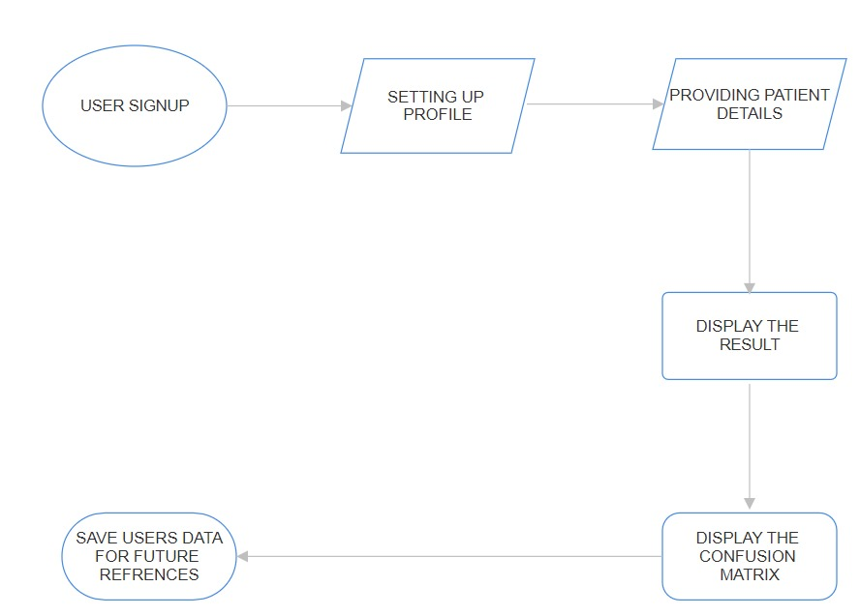

Slide 13
EXISTING AND PROPOSED SYSTEM
EXISTING SYSTEM
Most existing systems or tools use basic statistical methods or manually defined rules for predicting diabetes. These systems may rely on simple thresholds for blood glucose levels, BMI, or age to classify individuals as diabetic or non-diabetic. Existing systems, while effective, often suffer from limited accuracy due to their reliance on linear or shallow models that may not capture complex interactions between variables. They are also prone to false positives and negatives. Many existing systems focus on a few key health indicators (such as fasting blood sugar) without incorporating a more holistic view of the patient, such as lifestyle factors, family history, or genetic markers.
PROPOSED SYSTEM
The proposed system often introduces more sophisticated models, such as Random Forests, Support Vector Machines (SVMs), or Deep Learning models, which can better handle non-linear relationships and interactions between different health metrics. By using advanced techniques and larger datasets, the proposed system aims to improve the prediction accuracy, reducing false positives and negatives, and providing more reliable risk assessments. The proposed system might integrate additional data sources such as family history, lifestyle factors (e.g., physical activity, diet), and even genetic information to provide a more comprehensive risk profile. The proposed system may be designed for deployment in real-time platforms, such as web or mobile applications, where patients or healthcare providers can input data and receive immediate predictions, improving usability and accessibility.

Slide 14
SUMMARY
This methodology outlines the structured development of a machine learning-based diabetes prediction system. Key processes include user authentication, secure data handling, effective feature selection, robust model training, and performance transparency through a confusion matrix. Each step ensures accuracy, user engagement, and compliance with data privacy standards, ultimately delivering a reliable and user-friendly system.

Slide 15
THANKYOU

